Slide 1
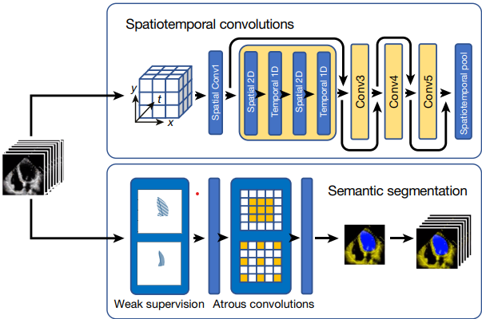
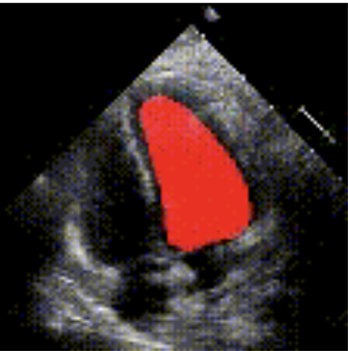
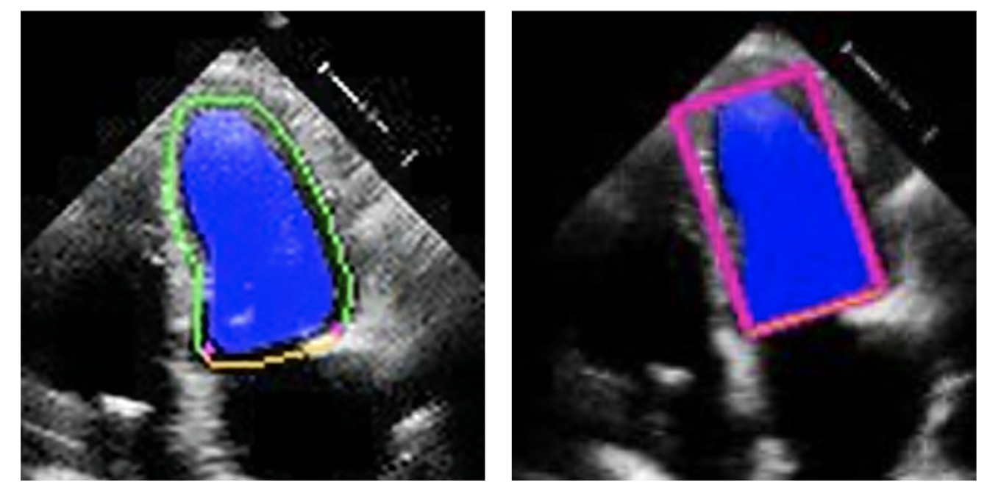
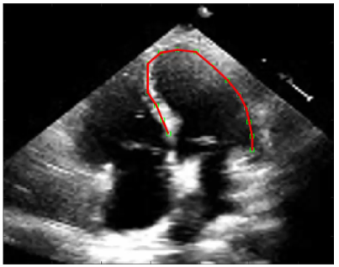
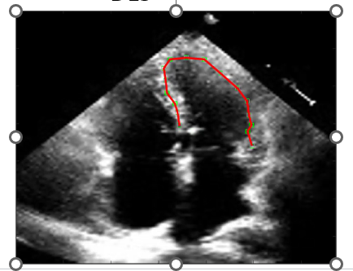
EchoNet-Dynamic Segmentation Model
Blood Pool Segmentation
Bounding Box Application
Contour Dilation
Feed Contour into Speckle Tracking
End Diastole
End Systole

Slide 3
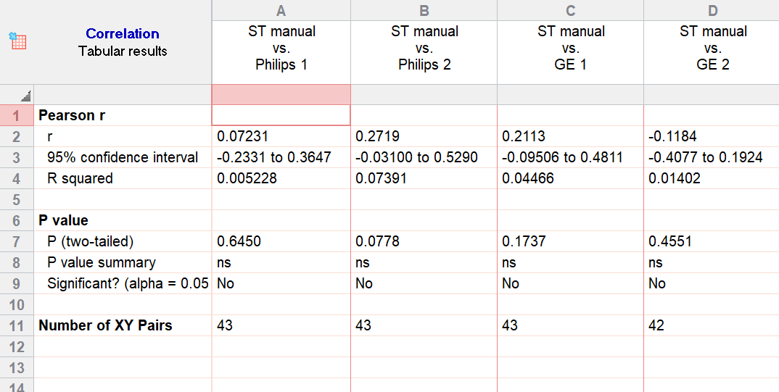
Manual vs. Philips 1
Manual vs. Philips 2
Manual vs. GE 1
Manual vs. GE 2

Slide 4
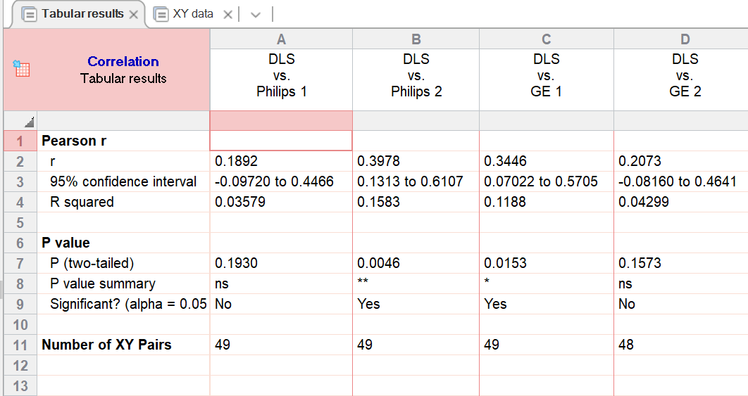
DLS vs. Philips 1
DLS vs. Philips 2
DLS vs. GE 1
DLS vs. GE 2

Slide 5
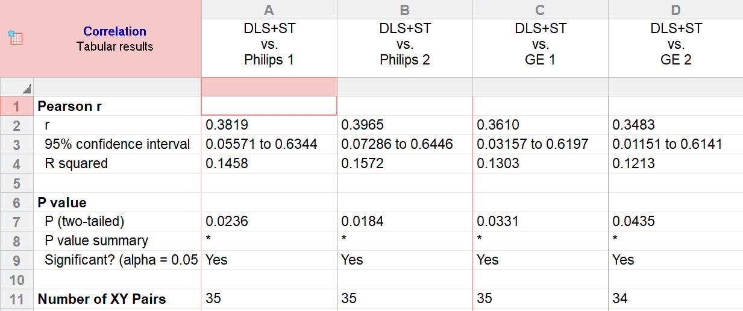
DLS + Speckle vs. Philips 1
DLS + Speckle vs. Philips 2
DLS + Speckle vs. GE 1
DLS + Speckle vs. GE 2

Slide 6
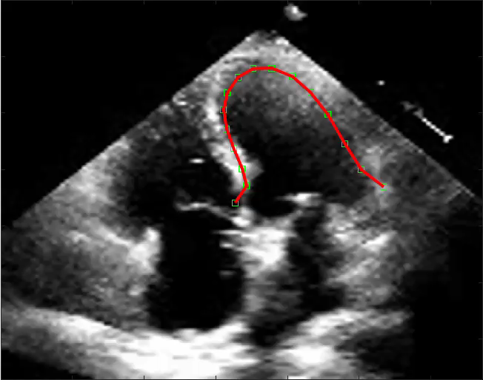
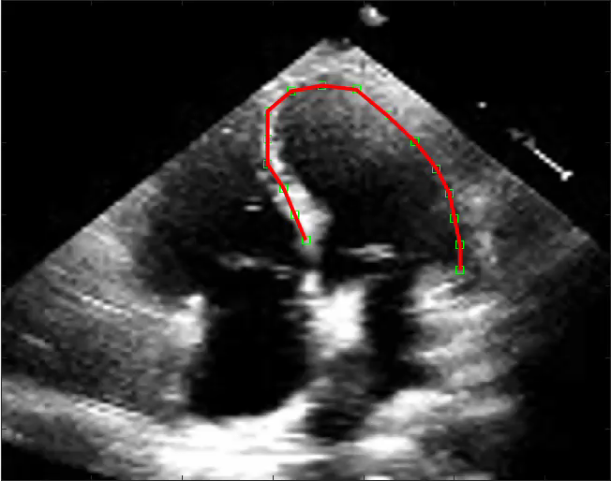
Speckle Tracking Manual
Pearce r: correlation Data
DLS

